Slide 1
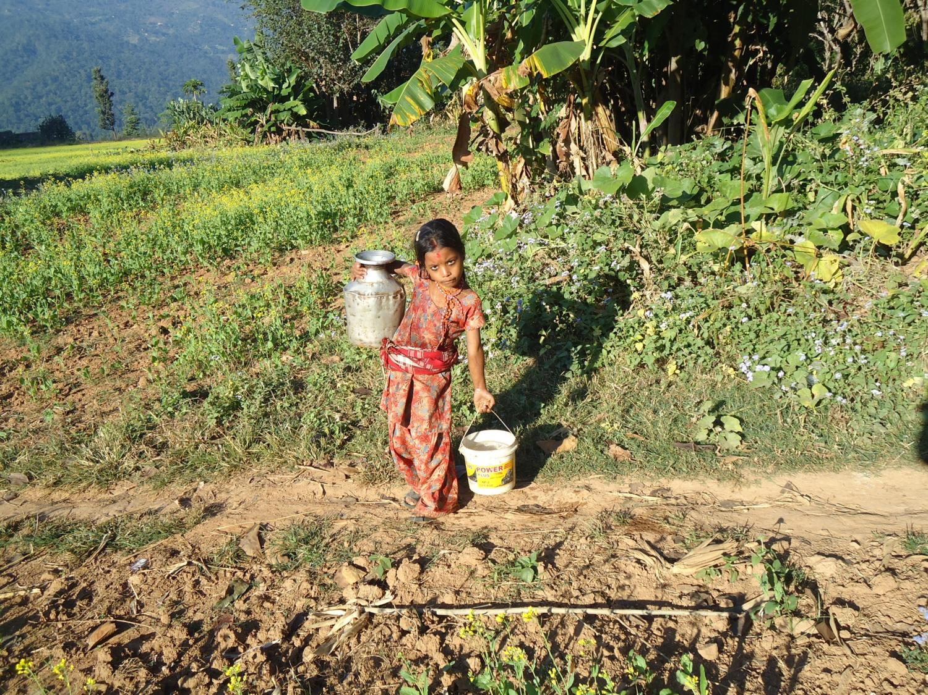
Multiple Use Systems: Experiences from Nepal
Indira Shakya
Technical Adviser
Rainwater Harvesting Capacity Centre
Biogas Sector Partnership Nepal
MUS Meeting 22-23 November 2010

Slide 2
Presentation Layout
Need for RWHS in Nepal
About Rainwater Harvesting Capacity Centre (RHCC)
Technologies in Use
Stakeholders/Partners
Project Process
Multiple use of RWHS
Impacts
Challenges
Way Forward

Slide 3
Role of Rainwater Harvesting in Rural Nepal
The Water and Poverty Nexus
Time consumed in collection of water and fuel wood
Small land holdings
Dependence on rainfall for agricultural production
Involvement of children in household chores

Slide 4
Need is for ………
Rainwater from
rooftop catchment
Primary Storage
Overflow
Secondary Storage
Plastic lined/compact clay ponds
For Drinking and Domestic use, biogas operation
For Kitchen Garden
For irrigation and livestock, biogas operation

Slide 5
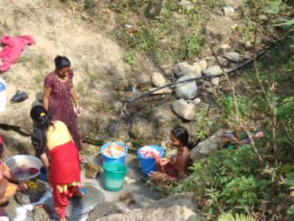
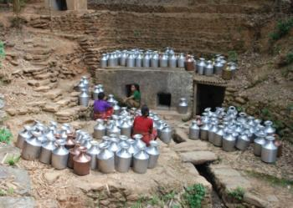
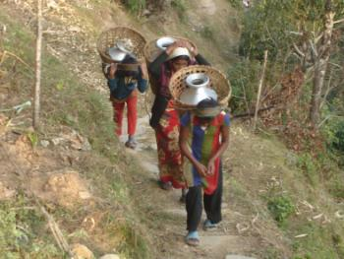
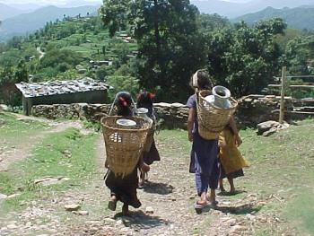
About the RHCC
Established in 2006
Objective: To enhance rural livelihood through Rainwater
Harvesting intervention
Major Roles of the RHCC
Advocacy and Lobby
Capacity Building
Research and Development
Data Management
Monitoring and Evaluation
Quality Management
Promotion and Dissemination
Fund Raising
Program Area Selection Criteria
Distance to exiting sources
Absence of any alternatives : boreholes, dugwells
Contamination of exiting sources

Slide 6
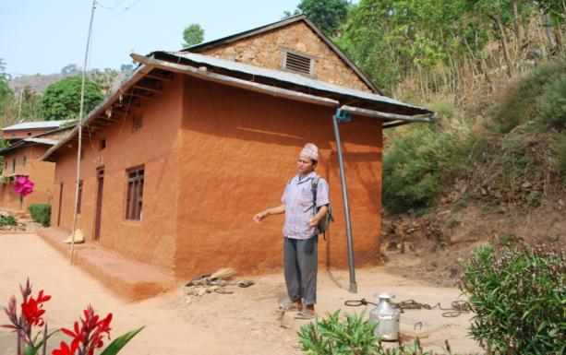
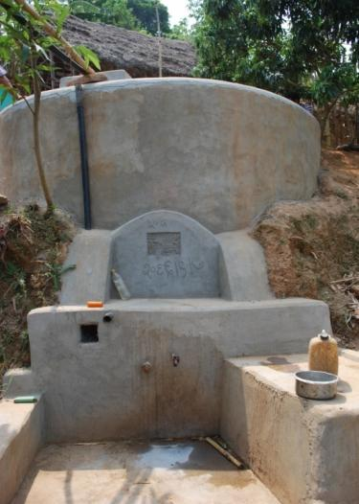
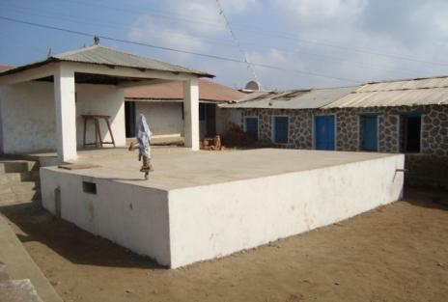
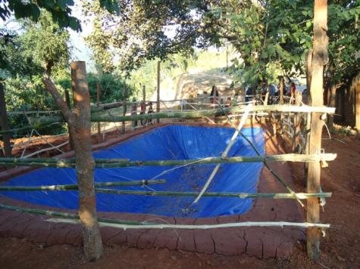
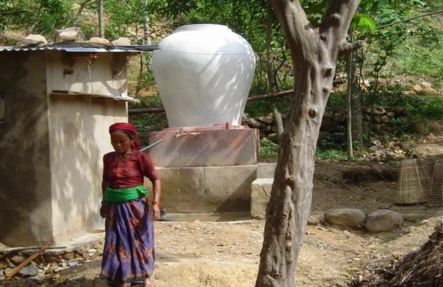
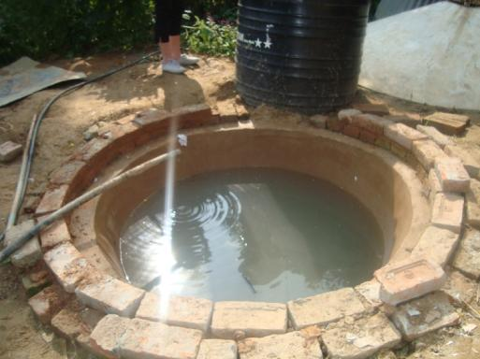
Technologies in Use

Slide 7
Water Demand used for design purpose
Information about the water use (current and future) | Drinking |  | Other domestic uses | Lives- tock | Irrigation | Biogas
 | HH | com | hh | hh | hh | hh
Average Water demand per person - dry season. | 0-1 | 0-1 | 1-3 | 3-10 | 0-1 | 3-10
Average water per person - rainy season. | 1-3 | 1-3 | 10-30 | 3-10 | 3-10 | 10-30
Extra water for each activity (average litres per person per day)? | 1-3 | 1-3 | 10-30 | 10-30 | 10-30 | 10-30

Slide 8
Technical Details
Systems used | Purpose | Capacity | Users | Cost
Ferrocement | Drinking, Micro irrigation | 1 – 6.5 m³ | Household | Rs 9/l
Brick Masonry | Drinking, Micro irrigation, operating biogas | 6 – 20 m³ | Household and community | Rs 8.5/l
Cement Concrete Reinforced systems | Drinking | 20 – 100 m³ | Community and Institutions | Rs 11/l
One Bag Cement Systems | Micro Irrigation | 1 – 3m³ | Household | Rs 3/l
Plastic Ponds Silpoulin, 150 GSM, IS 14611-1998 | Micro Irrigation, livestock | 18 – 72 m³ | Household Community | Rs 0.2 to .75 /l
Plastic Containers | Drinking, Micro Irrigation, | 1 – 4m³ | Household Institutions | Rs 15/l

Slide 9
Partnership in the RWH Program
National and Local Government Organisations
For Planning, Financial Support, Policy intervention
Social mobilization, awareness and capacity building
Non-Government Organisations
Operate, maintenance of system, monitor effectiveness of the system promote the product at local level
RWHS
Users
BSPN-RHCC
RWWH Funded by
RAIN Foundation
For RWHS construction/
Fabrication of accessories and installation; provide after sales service, develop local capacity to take over the task.
Private Enterprises
Micro Financing
Institutes
Provision of loan for installation of the system

Slide 10
Crucial Process in the Program
Practices, ; Resources and water Needs
Identification of community
Awareness Building
Support in Planning Process and fund Flow
Government
User Norms,; Local Contribution ; Wealth Ranking; Gender and
Ethnicity Issues
Local Bodies, Key Informants
Form User Groups
Site selection; Construction; Operation; Repair
Maintenance; Management and After sales service
Micro Financing , Small Credit Groups
Capacity Building
Implementation
Users
Water and Technical Quality; Adherence to Program needs and challenges
L
EGEND
Input
Stakeholders
Local Bodies
Program
External
M&E
Activity
Elements of focus

Slide 11
Types of MUS systems implemented
Upgrading by installing an ‘add-on’ to an existing system – biogas systems operation to meet drinking needs
Single-‘plus’, in which a single-use system is designed to meet drinking needs with provision for using overflow for micro irrigation (by default)
MUS by design where services are designed for multiple use from the start – drinking, operation of biogas systems, micro irrigation, livestock

Slide 12
Use of RWH by Purpose and Frequency, 2009 (No. of HHs)

Slide 13
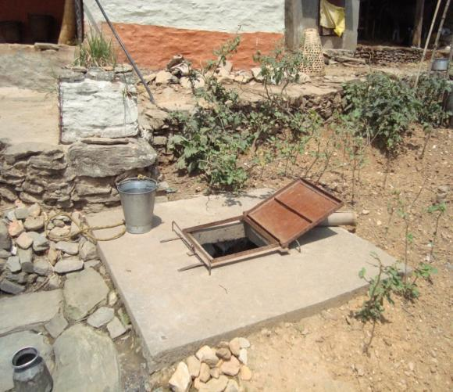
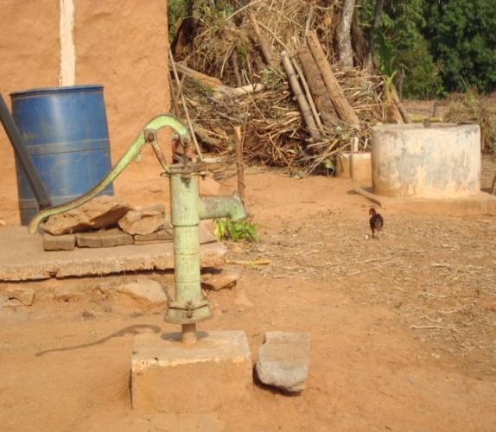
Improving the Technology
Improvement in accordance to Changes in User Behaviour

Slide 14
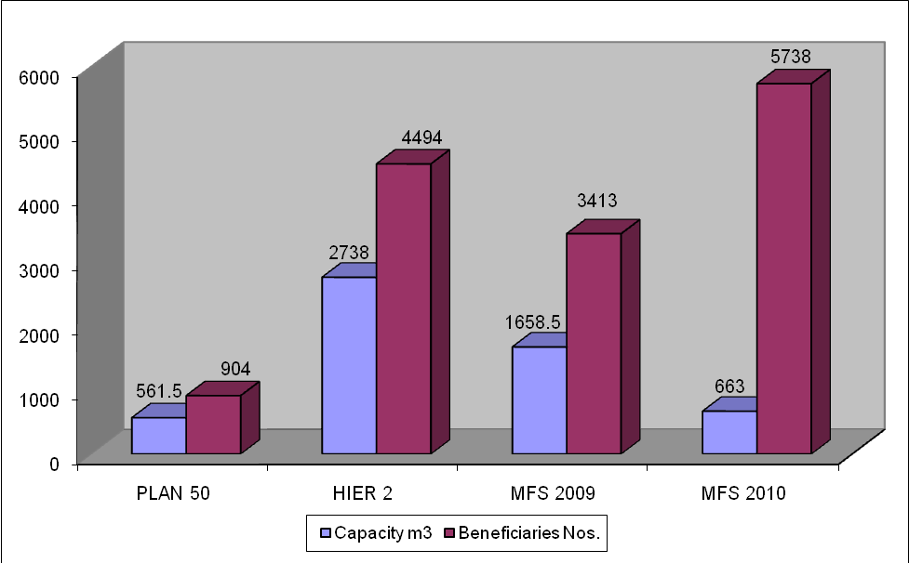
Activities and Achievements

Slide 15
Impacts as experienced by the users
Biogas plant performance:
Sanitation and health
Time Save and its Utilization
Education Opportunities
Impact upon economic/ income generating
Social Impact

Slide 16
The impact of the multi-use water system (MUS)
Families no longer have to make difficult journeys to rivers MUS provides families with water for cooking, drinking, washing, feeding livestock and irrigating crops: reducing hazards and saving time upto 3 hours a day
People can grow high value crops With more water available for irrigation, many farmers have high nutrition value vegetables for their families as well as grow new vegetables that fetch a high price at market.
No more having to choose between drinking and farming With MUS, poor families have no more worries about whether to use the water they have collected for drinking or irrigation? With this new technology there is enough for both.

Slide 17
The impact of the multi-use water system (MUS)
Households have access to clean energy
Households can also operate the biogas thus eliminating the task of collecting fuelwood and the burden t endure the smoky kitchen which has implications on their health
Households also have enough water to meet their hygiene needs Many people in the poorest areas had no water for washing, which often leads to disease. Now, with an MUS pumping water into their communities, families have been able to regain their health and dignity.
Women and Children have opportunities for livelihood enhancement
Being released from the task of collecting fuelwood and water , time saved provides opportunities for education for the children (girl child in particular) and income generation activities for women

Slide 18
Challenges
Cost – high cost as compared to conventional water service
Outreach difficulties due to terrain and scattered settlement of the community
Low priority of the government
Low literacy level and awareness amongst the most needy users
Lack of awareness amongst the decision makers

Slide 19
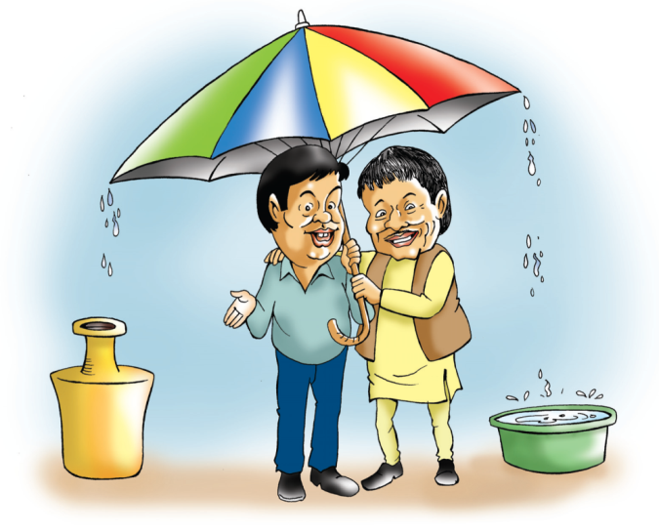
So Lets strive for a change …..

Slide 20
Way Forward
Private parties involvement for reducing cost of systems and setting up local service centre
Continuation of educating/awareness for users on different aspects
Multi-sourcing to be promoted specially for non-drinking purposes
Income-generating programs to be focused on for enabling higher economic benefits of the systems

