Slide 1
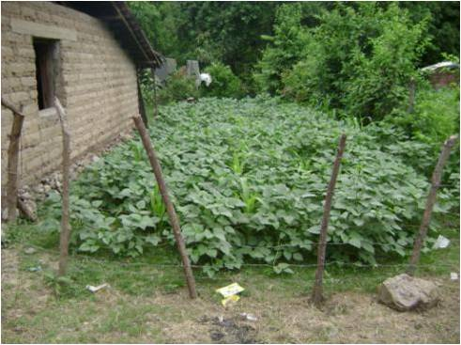
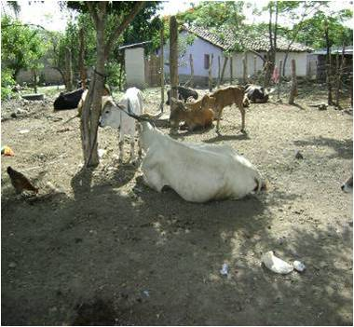
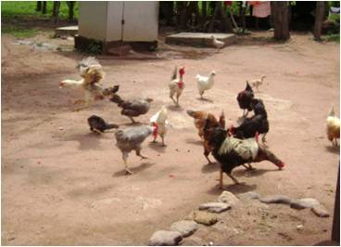
MUS pilot project in Honduras
Testing guidelines for planning and implementation of multiple use services
Notes:
Vale la pena incluir unas fotos mas

Slide 2
Background
In 2008, assessment of multiple use of water in 14 communities in Honduras which showed that
  MUS allows obtaining livelihood benefits, but with different degrees of impact for different user groups
  This is made possible to some extent due to over-design of existing infrastructure and a relatively high water resources availability
  It may have some impact on sustainability of services, but other factors are much more significant
  A range of measures were found that are put in place to ensure more sustainability and equity in service delivery, such as internal rules, differentiated tariffs and the use of alternative water sources, beyond the main water supply
Notes:
OK

Slide 3
Background
The study recommended:
  To support communities in developing local internal rules and regulations around water use for multiple purposes to improve sustainability and equity
  In rehabilitating existing systems, consider promoting MUS through: improving pipe networks, use overflow from tanks, and use obsolete infrastructure for productive purposes
  Develop new design parameters for new systems, based on actual consumption patterns
Notes:
Ok

Slide 4
MUS Pilot project
The results of the study were shared through RASHON (Water and Sanitation Network of Honduras), including to FHIS (Honduran Social Investment Fund), the government agency responsible for constructing water systems
The idea for a pilot project was quickly conceived and approved within one of the WB funded water programmes:
  WB staff attended the inauguration ceremony of a water supply system in one of the communities
  At the walk through the community, it was observed that already on the first day the overflow of the distribution tank was used to irrigate potato fields
  This triggered many question of the WB staff on the future of the system. Why not develop a MUS system from the onset, to prevent unauthorised and unregulated water use for irrigation?
Notes:
Ok

Slide 5
MUS Pilot project
After this, FHIS proposed to carry out 2 MUS pilot projects, supported by the WB
With the objective of assessing of what needs to change to the project cycle to include MUS in each of its steps
Hence, the idea arose to develop a guideline for planning and implementation MUS to support these two pilot projects, but also for subsequent upscaling
Notes:
ok

Slide 6
MUS Guidelines
Target audience: engineers, technicians and social workers, supporting the planning, design and implementation of rural water supply systems
Consisting of 3 parts:
  Part 1: conceptual framework, summarizing key concepts and findings related to MUS
  Part 2: MUS in the project cycle: detailing for each step in the cycle how to address MUS and which tools to use for that purpose
  Part 3: tools. This provides an overview of different (participatory) tools and methods to address MUS in each step
Notes:
OK

Slide 7
Project cycle
Post-construction support
Evaluation
Identifying demand
Implementation
Assessment
Design
Studying feasibility of alternatives
Notes:
Sugiero que despues de esta slide dices que solo enfocas en los pasos de assessment and studying feasibility of alternatives

Slide 8
Assessment
Objective: to get a detailed understanding of actual multiple use practices, their impact on sustainability of existing water systems and possibilities to improve these
Key issues to address in this step include: identifying user categories, their different water use patterns, and availability of water resources and existing infrastructure
Tools:
  User categorization
  Community mapping
  Inspection of existing infrastructure
  Water resources assessment
  Analysis of water consumption pattern
  Focus group discussions with water committee and users
Notes:
Ok

Slide 9
Feasibility of alternatives
Objective: to analyse the technical, financial and social feasibility of varies (conceptual) intervention alternatives, and agree on which ones to elaborate in a detailed design
Key issues: design parameter implications, cost implications, analysis of alternatives
Tools:
  Identifying which design “scenario” to follow:
    Scenario 1: productive use is insignificant compared to other domestic uses now and probably in the future. Conventional design parameters can be used
    Scenario 2: there is some productive water use, which is likely to grow in the future. However, it is not necessary to develop a specific MUS design, as the amounts of water needed fit within existing design parameters. However, there is need to develop specific internal regulations around water use
    Scenario 3: there is a significant amount of water used for production and this is likely to increase in the future. Specific design parameters need to be considered and specific infrastructure may need to be developed for this. Besides, there is need to develop specific internal regulations around water use
  Technology selection tools
  Community meeting to analyse and select alternatives

Slide 10
Table used for typical consumption patterns
User category | Types of productive use | Median consumption for productive use (l/p/d) | Range of productive consumption from the water supply systems (l/p/d) | Median consumption for productive use from water supply system(l/p/d)
People working outside agriculture | Some small animals and trees | 2.7 | 1-20 | 2.7
Subsistence farmers | Some animals (chickens, cows, pigs) and a backyard garden | 12.3 | 1-60, with some users > 200 | 11.0
Small and medium farmers | Farm animals, irrigation of vegetables and backyard gardens, processing coffee | 135.0 | 1-150, but some users > 150 | 40.3
Big farmers | Crop irrigation and livestock | 483.7 | 0-200 | 67.3
Cattle ranchers | Water for large number of livestock, pig and poultry farms, fish farms | 280.0 | 20-200 | 87.5
Businesses | Water for small and medium industries, such as brick making, hotel, and cheese making | 82.7 | 1-125 | 8.0
Notes:
Sugiero que solo incluyas esta tabla, en vez del texto que tenias. Tal vez puedes mencionar los consumos para usos domesticos. Tambien puedes incluir unas fotos de los consumos

Slide 11
Progress on the MUS pilot project
Activities carried out so far:
Training and discussion workshop with engineers and technicians to get inputs for the guidelines
Development of the guideline document
Selection of communities where the guidelines would be tested
Further induction of engineers and technicians
Applying the assessment and feasibility steps of the guidelines in 6 communities in the Department of La Paz
Notes:
Ok, y puedes agregar que se esta haciendo el diagnostico y analisis de factibilidad en este momento

Slide 12
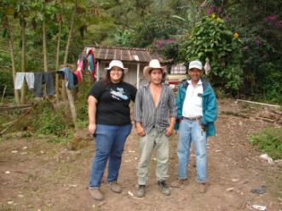
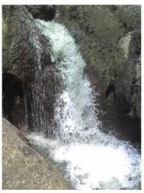
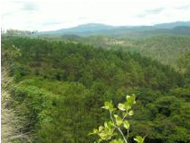
Case of guideline application
Community: Culizanba, La Paz
Number of households: 37
Population: 246 persons
Type of water source: surface water
Currently, there is no formal water supply system; people use hosepipes from the river to their homestead

Slide 13
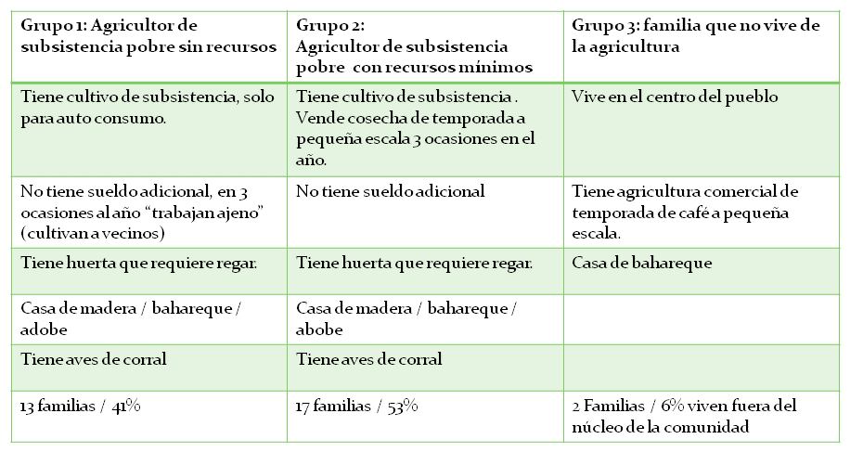
User categorization
Notes:
No logre traducirla. Pero creo que solo la muestras en espanol, explicando que se hizo la categorizacion, sin entrar en los detalles de cada grupo

Slide 14
Example of design calculation
User category | Subsistence farmers | Small and medium farmers
% population | 41% | 59%
Median productive use from water supply systems(l/p/d) | 11 | 40.3
Median productive use from water supply systems(Galons/p/day) | 2.91 | 10.65
Median domestic design norm(Galons/p/day) | 25 | 25
Average design supply (Galons/p/day) | 27.91 | 35.65
Total supply (Galons per day) | 2196.75 | 4037.99
Total supply for community (Galons per day) | 6234.75
Average supply (Galons per person per day) | 32.47
Usual design norm in Honduras: 30 Galons/p/day
Notes:
Aqui te va el calculo. Creo que lo que deberias enfatizar que la dotacion requerida es un 10% mas alto de la dotacion normalmente usada.

Slide 15
Selection of feasibility of alternatives
In order to facilitate MUS, this community needs a design supply of 10% higher than what normally would be used as design norm
Not yet an assessment of cost implications, but probably very modest cost increase
Notes:
ok

Slide 16
First lessons learnt
The guideline allows to systematically assess the community demands and expectations
But in order to capture those, a good level of trust is needed between community and the outside engineers and technicians
The quality of the application of the guidelines also depends on the skills and attitude of the engineers and technicians: they demand more openness and creativity
When presenting alternatives, it is important that the community understands both the benefits and the cost implications of each alternative
One difficulty in applying the guidelines is still the extrapolation of actual water use patterns to expected future needs
Notes:
ok

Slide 17
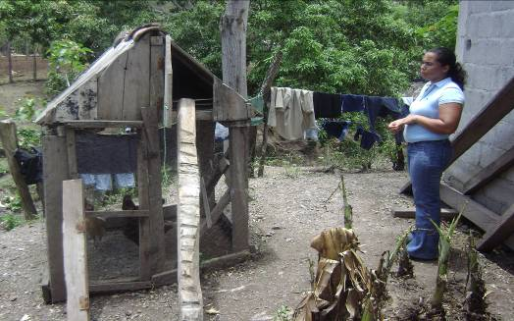
“Multiple-use services are all about changing perspectives”.
Notes:
ok

