Slide 1
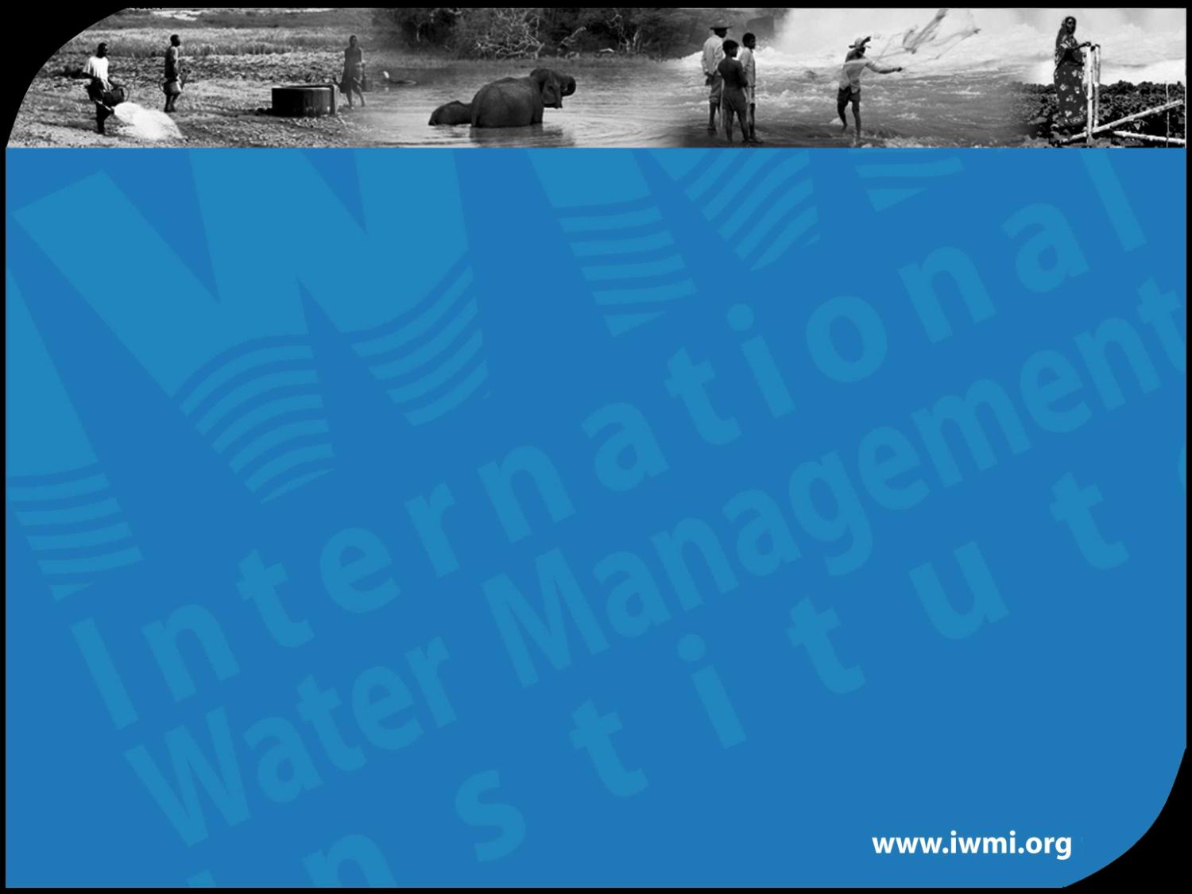

Regional Water Sector Programme
Programme Support Facility
A SADC initiative funded by Danida
Community-driven MUS
What and Why?
Based on
MUS Project CPWF28
SADC/DANIDA IWRM Demonstration projects

Slide 2
Community-driven MUS:
‘Local government planning – plus’
Responsible Organization | Phases | Steps | Steps
Creating a supportive environment |  |  | Continuous ‘Step’ Seven: Do participatory monitoring and evaluation and impact assessment for follow-up
Local authorities and support agencies | Initial | Step One: Mobilize support
 |  | Step Two: Select communities
Participatory planning, implementation and monitoring
Communities facilitated by local structures and support agencies | Participatory planning | Step Three: Understand the community and build capacity
 |  | Step Four: Create a vision and select activities to fulfil it
 |  | Step Five: Compile action plans
 | Implement- ation | Step Six: Implement the action plans

Slide 3
Why community-driven MUS?
More livelihood benefits for own priorities, especially by the poorest and women (if targeted)
More water resource and technological
efficiency & resilience
Stronger and more sustainable local institutions
‘Local government planning–plus’: scalable nation-wide

Slide 4
1. More livelihood benefits for own priorities, especially by the poorest and women (if targeted)
Including the marginalized from earliest planning onwards (e.g. in technology choice and site selection)
Multiple uses for all MDGs
Priority uses by gender, wealth& livelihood (priority for homestead-scale MUS?)
Priority interventions in longer-term vision

Slide 5
2. More water resource - and technological efficiency and resilience
  taking all existing infrastructure as sunk costs
  tapping local technical knowledge
  integrating full water cycle: (re-) use & waste
  combining multiple sources for resilience
  considering full project cycle, incl. maintenance and rehabilitation
  economies of scale in infrastructure
  avoiding infrastructure damage of non-planned uses

Slide 6
3. Stronger and more sustainable
local institutions
  building on century-old institutional capital for integrated water self-supply for multiple uses from multiple sources
  integrating new institutions (‘water committees’ ) in one-window participatory processes

Slide 7
4. ‘Local planning – plus’:
scalable nationwide
Local government’s mandate:
  service delivery
  resource management
  accountability and transparency
  local knowledge and relationships
  cost-effectiveness
  sustainability

Slide 8
Next pilot testing/tool development
for community-driven MUS, e.g.:
integrated water resource&needs assessment
community empowerment, transparency and accountability in financing streams
participatory technical feasibility assessment and technology choice
translation of options into bankable work plans
reaching the marginalized
integration in local planning and accountable relationships with service providers
support at intermediate and national level
cost-benefits analysis
etceteras

Slide 9
Thank you

